Slide 1
CHM202:
Energetics and dynamics of chemical reactions
Slides for online lectures
Must be followed along with recommended textbook by Atkins (8th or later edition) or any other reference book

Slide 2
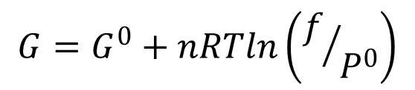

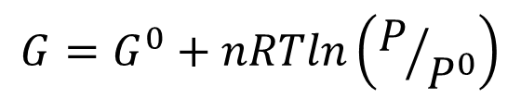
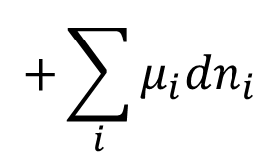
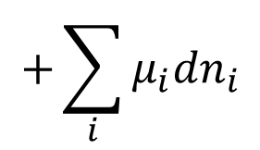
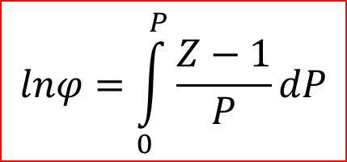


$$+\sum_{i}{μ_{i}{dn}_{i}}$$
$$dU=TdS−PdV$$
Reversible change
$$+\sum_{i}{μ_{i}{dn}_{i}}$$
$$dG=−SdT+VdP$$
Reversible change
$$G=G^{0}+nRTln\left(P/{P^{0}}\right)$$
Reversible change, constant temp, ideal gas
$$G=G^{0}+nRTln\left(f/{P^{0}}\right)$$
f: fugacity
Reversible change, constant temp, ALL gases
$$f=φ×P$$
$$lnφ=\int_{0}^{P}{\frac{Z−1}{P}dP}$$
Atkins’ Physical Chemistry,
8th Ed, page 111

Slide 3
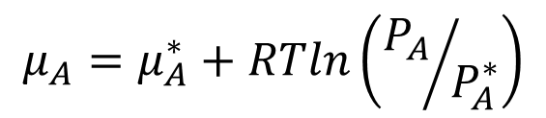

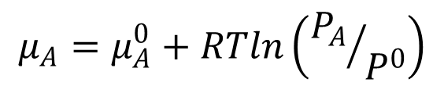
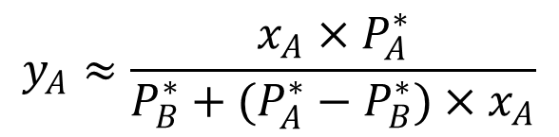



$$μ_{A}=μ_{A}^{0}+RTln\left({P_{A}}/{P^{0}}\right)$$
Reversible change, constant
Temp, ideal vapour
Vapour
A + B
y_{A} + y_{B} = 1
P_{A} & P_{B}
$$μ_{A}=μ_{A}^{∗}+RTln\left({P_{A}}/{P_{A}^{∗}}\right)$$
Exact! (no approximation yet
other than vapour behaves ideally)
Liquid
A + B
x_{A} + x_{B} = 1
$${P_{A}≈x}_{A}×P_{A}^{∗}$$
Raoult’s Law (Ideal solution)
Solvent in almost pure form
$$μ_{A}≈μ_{A}^{∗}+RTlnx_{A}$$
$$y_{A}≈\frac{x_{A}×P_{A}^{∗}}{P_{B}^{∗}+(P_{A}^{∗}−P_{B}^{∗})×x_{A}}$$
Atkins’ Physical Chemistry,
8th Ed, page 145
Henry’s Law
(“Ideal” dilute solution)
Solute in low concentration
$${P_{B}≈x}_{B}×K_{B}$$
$$μ_{B}≈μ_{B}^{∗}+RTlnx_{B}$$

